Slide 1
CMMI Marketing Talks
Quarterly Meeting
June 2025

Slide 2
Agenda
Introduction
Speaker: Yujel Tepekoy
Topic: CMMI V3: From Compliance Checkbox to Strategic Enabler
[NEW] Marketing Resource Center Overview
QA

Slide 3

CMMI V3:
From Compliance Checkbox
to Strategic Enabler
In today's rapidly evolving business landscape, organizations face unprecedented challenges in security, data management, workforce development, and AI integration. CMMI V3 has transformed from a mere compliance framework to a comprehensive strategic enabler that addresses these critical domains.
Let’s explore how we can reposition our services as high-value strategic investments rather than commodity requirements.
Let’s examine how the expanded CMMI V3 model creates measurable, mature capabilities that modern enterprises actively seek for transformative performance improvement.

Slide 4






The CMMI Crossroads: Beyond the Mandate
Strategic Value
CMMI as a driver of business excellence
Paradigm Shift
From "pushed compliance" to "pulled value"
Current Perception
CMMI as merely a compliance "checkbox"
The CMMI marketplace stands at a critical juncture. For too long, organizations have viewed CMMI primarily as a mandated checkbox for bidding requirements, failing to recognize its transformative potential. This limited perception undervalues the framework's comprehensive capabilities.
CMMI V3 represents a fundamental evolution, addressing modern enterprise needs beyond traditional development and services domains. Our challenge is to shift the paradigm from compliance-driven adoption to value-seeking implementation, where organizations actively pursue CMMI for its strategic benefits.

Slide 5
CMMI for Security: Beyond Basic Compliance
Traditional Security Frameworks
CMMI for Security Value-Add
ISO 27001 and NIST provide baseline security standards and compliance requirements for organizations to follow.
CMMI SEC takes security management to the next level by focusing on the maturity and effectiveness of your security processes.
Focused on control implementation
Limited assessment of process maturity
Measures process repeatability
Minimal emphasis on continuous improvement
Assesses continuous improvement capability
Provides quantitative maturity measurement
Complements existing frameworks
While ISO 27001 and NIST frameworks establish essential security controls, they often fall short in measuring how effectively these controls are implemented and maintained. CMMI for Security fills this critical gap by evaluating the maturity, repeatability, and measurability of an organization's Information Security Management System.
This approach transforms security from a static compliance exercise into a dynamic capability that evolves with emerging threats. By articulating this distinction, CMMI professionals can position their services as high-value investments that deliver continuous security improvement rather than point-in-time certifications.

Slide 6








CMMI for Data: Maturity in the Information Age
Data Governance
Data Security
Structured policies and procedures for data management
Protection measures for sensitive information
Process Maturity
Data Analytics
Ensuring consistency and improvement in data practices
Transforming data into actionable insights
In today's data-driven economy, organizations struggle to establish consistent, secure, and value-generating data practices. CMMI for Data addresses this challenge by providing a comprehensive framework for assessing and improving data management maturity.
Unlike traditional data governance frameworks that focus primarily on policies, CMMI for Data evaluates the entire data lifecycle through the lens of process maturity. This approach ensures that data practices are not only well-defined but also mature, repeatable, secure, and measurable.
By positioning CMMI for Data as the bridge between data governance and business intelligence, practitioners can demonstrate tangible value that resonates with C-suite executives concerned with data-driven decision making.

Slide 7
CMMI for People: Elevating Workforce Excellence
Beyond Traditional HR
Appraisable Best Practices
Continuous Improvement
CMMI for People transcends standard HR functions by focusing on measurable workforce capabilities and performance outcomes rather than just policies and procedures.
Provides objective assessment of workforce strategies through concrete, observable practices that can be evaluated and improved systematically.
Establishes a framework for ongoing workforce development that adapts to changing business needs and measures progress quantitatively.
While most organizations acknowledge that "people are our greatest asset," few have systematic approaches to developing and measuring workforce capabilities. CMMI for People fills this gap by providing appraisable best practices that transform human resource management from an administrative function to a strategic enabler.
By focusing on the maturity of workforce processes, CMMI for People enables organizations to build high-performing, empowered teams with consistent, measurable outcomes. This approach resonates with executives seeking to address talent challenges in an increasingly competitive marketplace.

Slide 8




CMMI for AI: Guiding the Next Frontier
Ad-hoc Experimentation
Isolated AI projects with inconsistent approaches and unpredictable outcomes
Process Definition
Establishing standardized methods for AI development, testing, and deployment
Measurement & Control
Implementing metrics and feedback loops to evaluate AI performance
Strategic Integration
Embedding mature AI capabilities into core business operations
As organizations rush to implement AI solutions, many struggle with inconsistent approaches, ethical concerns, and unreliable outcomes. The emerging CMMI for AI addresses these challenges by providing a structured pathway to integrate AI in a process-based, measurable, and repeatable manner.
This framework guides organizations from sporadic AI experimentation to strategically embedded, reliable AI capabilities. By positioning themselves as guides through this AI maturity journey, CMMI practitioners can tap into one of the most pressing business priorities today, offering immediate and significant value that transcends traditional compliance requirements.

Slide 9



The CMMI Appraisal Advantage
Objective Assessment
Impartial evaluation of organizational capabilities
Maturity Benchmarking
Clear measurement against industry standards
Improvement Roadmap
Structured pathway for capability enhancement
The CMMI appraisal and characterization methodology represents a unique value driver that distinguishes it from other frameworks across all domains. Unlike self-assessments or basic audits, CMMI appraisals provide rigorous, evidence-based evaluations conducted by certified professionals.
This methodology delivers actionable insights that quantify organizational maturity and identify specific improvement opportunities. By emphasizing this distinctive approach, practitioners can differentiate CMMI services from competing frameworks that lack comparable assessment rigor.
Position the CMMI appraisal as not just an evaluation but a strategic consultation that delivers a customized roadmap for organizational excellence tailored to specific business objectives.

Slide 10




Shifting the Narrative: Value-Based Messaging
Security Messaging
Data Messaging
"Is your Information Security Management System truly mature and effective? CMMI provides the evidence-based proof that stakeholders demand."
"Are your data practices consistently delivering measurable business value? CMMI for Data ensures your information assets are properly governed and leveraged."
People Messaging
AI Messaging
"Are your workforce strategies demonstrably mature and empowering excellence? CMMI for People quantifies your human capital capabilities."
"Is your AI adoption strategic and mature, or ad-hoc? CMMI for AI builds the pathway to reliable, integrated AI that delivers consistent value."
Successful CMMI practitioners must shift their communication from technical certification language to business value messaging. This requires connecting CMMI solutions directly to executive-level concerns like risk management, operational efficiency, innovation capacity, and competitive advantage.
When engaging with potential clients, focus on capability building and performance optimization rather than compliance requirements. Frame CMMI as an investment in organizational excellence that delivers measurable returns across multiple business dimensions.

Slide 11




Making CMMI Irresistible: The Value Attraction Model
Holistic Excellence
Strategic Entry Points
Compelling Narratives
Strategic Partnership
Position CMMI V3 as an integrated framework addressing interconnected organizational capabilities
Use new domains like AI and Security as compelling gateways for client engagement
Develop case studies and success stories focused on business outcomes and ROI
Position your services as ongoing collaboration for continuous improvement
To transform CMMI from a compliance requirement to a sought-after solution, practitioners must build and communicate value that attracts demand. This "Build Value, Attract Demand" model positions CMMI V3 as an irresistible framework for organizations serious about developing mature, measurable capabilities.
Showcase CMMI V3 as a comprehensive system that addresses interrelated organizational needs rather than isolated domains. Leverage emerging areas like AI and Security as compelling entry points that address immediate executive concerns, then expand engagement to demonstrate the value of integrated capability improvement.
Develop narratives that connect CMMI implementation to tangible business outcomes, positioning your services as a strategic partnership for continuous improvement and future-readiness.

Slide 12
Taking Action: Your Path Forward
Develop Domain Expertise
Reframe Your Value Proposition
Deepen your knowledge in emerging areas like AI, Security, and Data to position yourself as a trusted advisor. Create specialized service offerings that address high-priority business challenges.
Revise marketing materials and client communications to emphasize strategic value over compliance requirements. Focus on business outcomes specific to each CMMI domain.
Engage at Executive Level
Build Success Narratives
Elevate conversations beyond technical practitioners to C-suite decision makers. Connect CMMI capabilities directly to strategic business objectives and competitive differentiation.
Document client success stories that demonstrate measurable business impact. Use these narratives to illustrate the transformative potential of mature organizational capabilities.
The transformation of CMMI from compliance checkbox to strategic enabler begins with you. By implementing these actionable steps, you can elevate your CMMI practice and deliver unprecedented value to clients across all domains.
Remember that repositioning CMMI V3 is not just about changing how we talk about it—it's about genuinely delivering on the promise of measurable capability improvement that drives business success. As you implement these strategies, share your experiences and insights with the broader CMMI community to collectively elevate our profession.
Together, we can ensure that CMMI V3 is recognized as the essential framework for organizational excellence in security, data, people,
and artificial intelligence.

Slide 13
Q&A

Slide 14
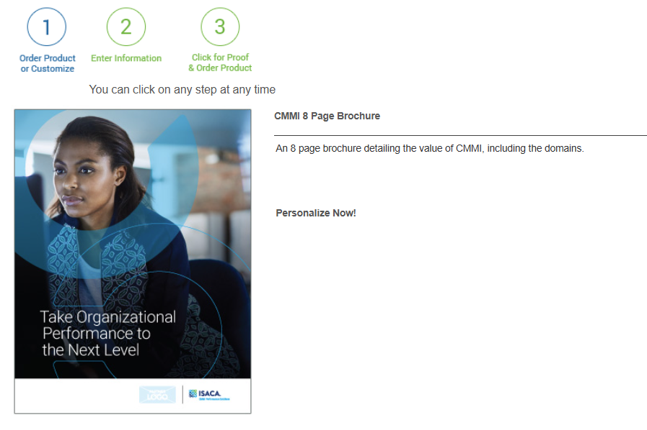
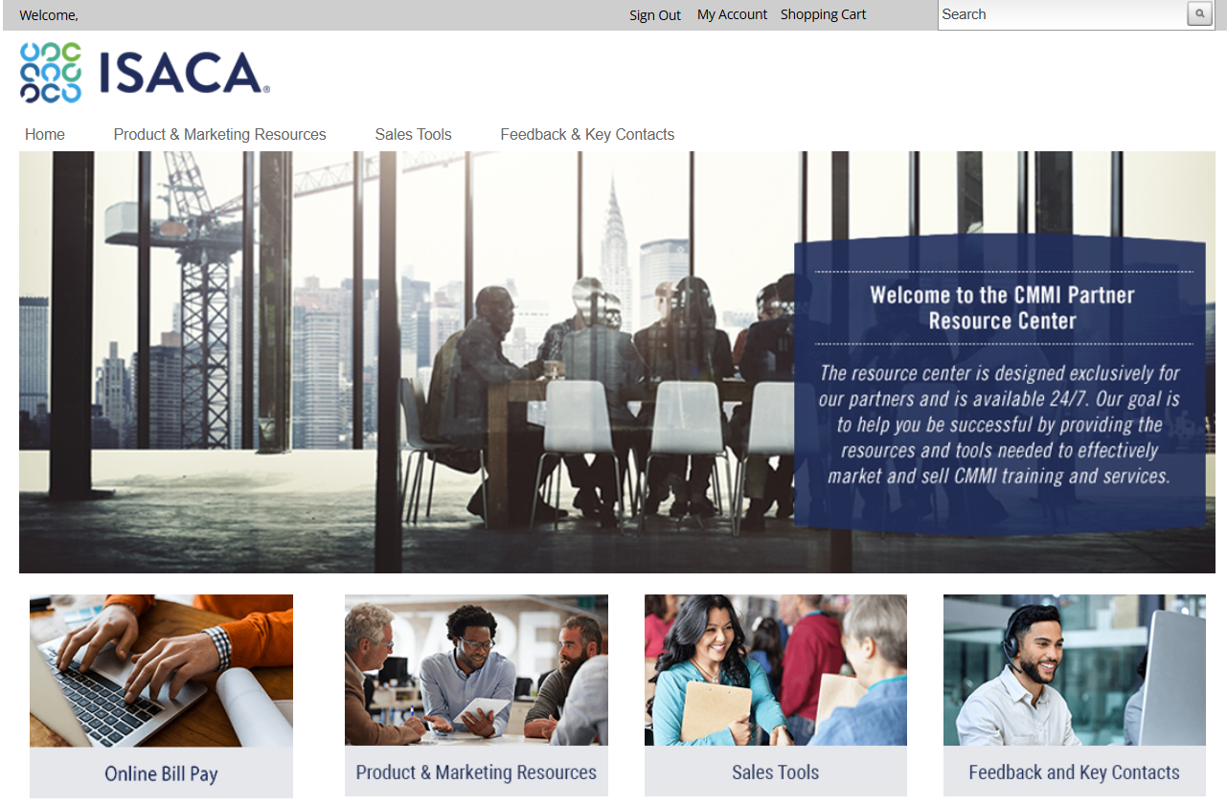
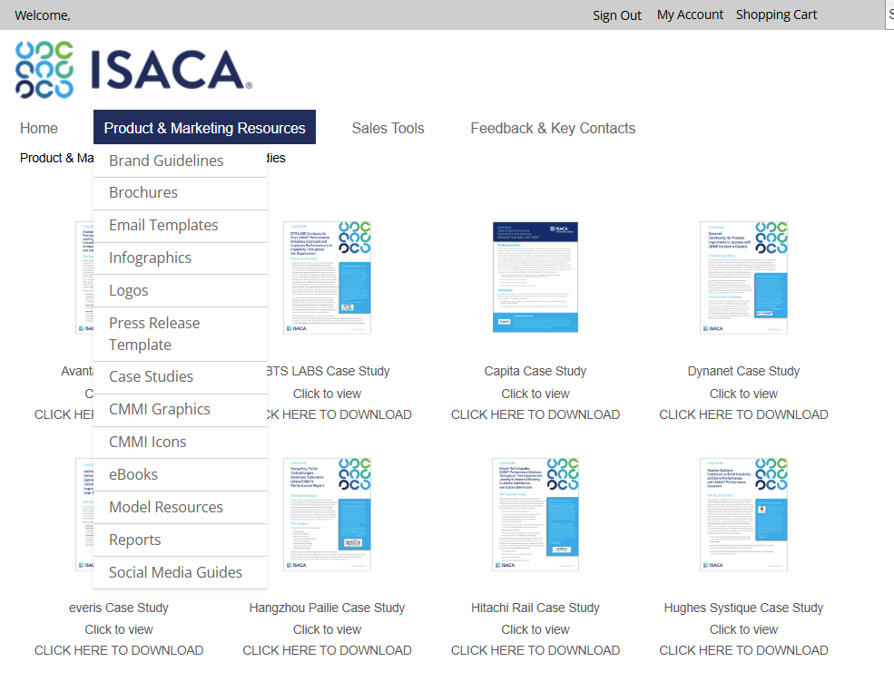
NEW – CMMI Partner Marketing Resource Center
Launched May 1
Notes:
KP

Slide 15
NEW – CMMI Partner Marketing Resource Center
Access the resource center through the CMMI dashboard or at this link: https://www.isacachannelpartners.com/channelmarketing/samlcmmisp.ashx
What's New?
Improved User Interface: Better user experience to help you find what you need quickly and effortlessly – and without the need to download the full toolkit!
Better Searchability and Browsing: Enhanced search functions and organized categories make it easier to locate the resources you need.
Enhanced Previews: Preview content before downloading, ensuring you get exactly what you're looking for.
Cobranding Capabilities: Select materials can now be cobranded, allowing you to add your logo and personalize the content.

Slide 16
LIVE DEMONSTRATION

Slide 17
Q&A
If you have additional feedback or questions, please contact Kim at kpalastro@isaca.org or Lindsey at lmarshall@isaca.org.

Slide 18
Notes:
All

